Slide 1

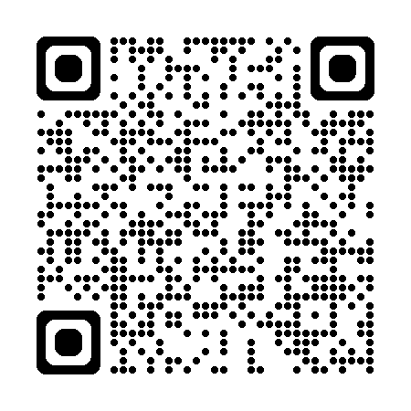

Slide 2







Who is Chad Green?
chadgreen@chadgreen.com
TaleLearnCode
ChadGreen.com
ChadGreen & TaleLearnCode
ChadwickEGreen

Slide 3
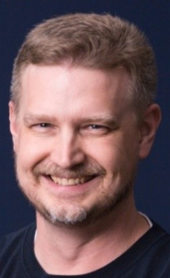
Who is Sean Whitesell?

Slide 4
Who is Sean Whitesell?
chadgreen@chadgreen.com
TaleLearnCode
ChadGreen.com
ChadGreen & TaleLearnCode
ChadwickEGreen

Slide 5
Agenda
Morning
Afternoon
08:00 – Welcome and Introduction
08:20 – Fundamentals of Messaging Patterns
09:00 – Lab Exercise: Publish/Subscribe Messaging
09:45 – Quick Poll & Recap
09:55 – Routing and Processing
10:40 – Lab Exercise: Dead-Letter Queues
11:25 – Quick Poll & Pre-Lunch Wrap
11:30 – Lunch Break
12:30 – Afternoon Recap
12:45 – Advanced Processing Techniques
13:30 – Lab Exercise: Claim Check
14:15 – Quick Poll
14:25 – Resilience and Reliability
15:10 – Lab Exercise: Circuit Breaker
15:55 – Quick Poll
16:05 – Streaming and Integration Patterns
16:25 – Design Considerations
16:40 – Wrap-Up, Q&A, Next Steps

Slide 6
Objective & Learning Outcomes
Objective
Equip attendees with the knowledge and skills to design, implement, and optimize message systems.
Learning Outcomes
Understand fundamentals and advanced messaging patterns.
Apply best practices to real-world scenarios.
Gain hands-on experience through practical exercises.
Develop the ability to design resilient and efficient messaging systems.

